Slide 1


Generative AI
Motaz Saad

Slide 2

Copyright Notice
These slides are distributed for educational purpose under the Creative Commons License. https://creativecommons.org/licenses/by-sa/2.0/legalcode
Source of Slides:
DeepLearning.AI as the source of the slides.
Generative AI :)
Harvard Teaching and Learning Consortium

Slide 3
Introduction to Gen AI
A gentle intro :)

Slide 4

What is AI?
Human intelligence (HI): ability to learn, think, solve problems, ....
Artificial Intelligence (AI): enable computer to learn, think and solve problems.

Slide 5
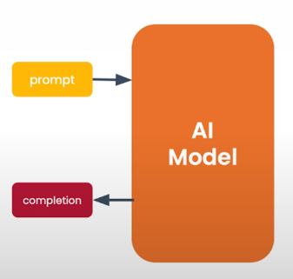
What is generative AI?
Gen AI is an Artificial intelligence systems that can produce high quality content, specifically text, images, and audio.

Slide 6
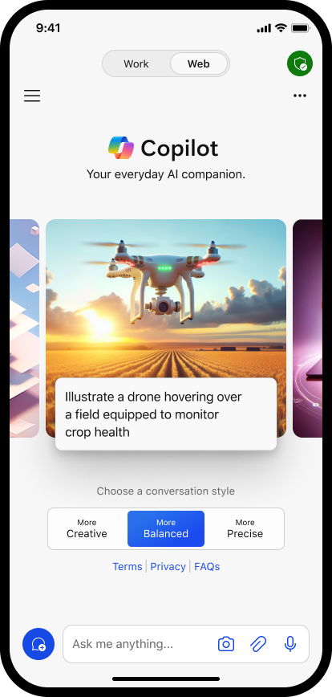
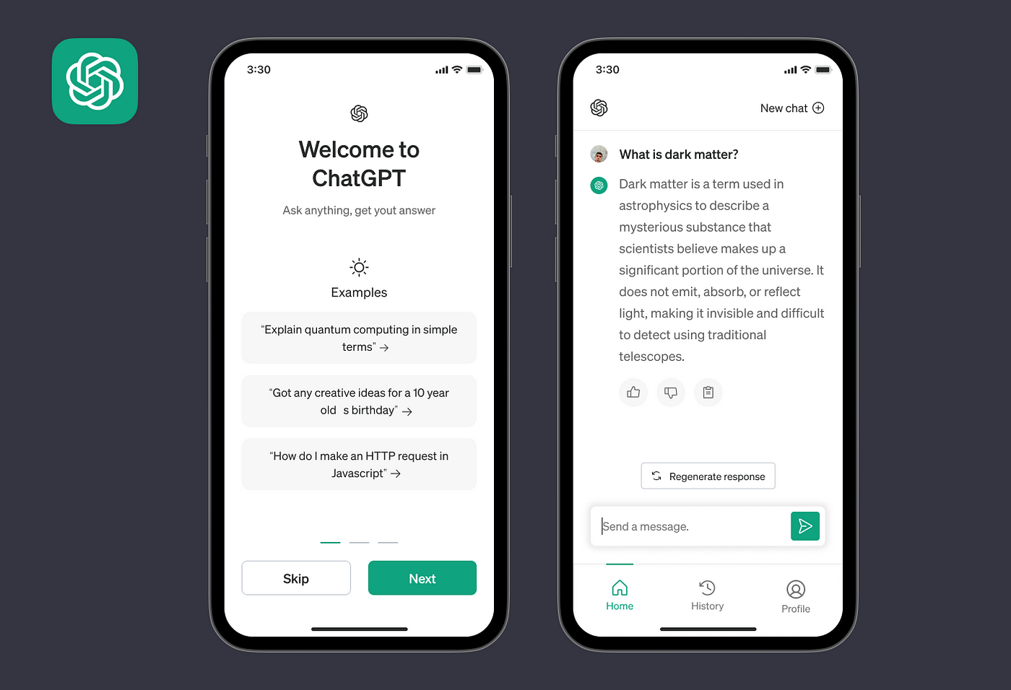
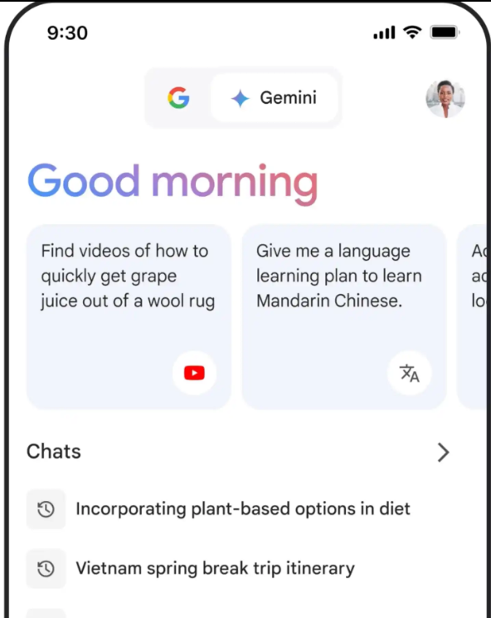


Gen AI Tools for end users (mobile App)

Slide 7
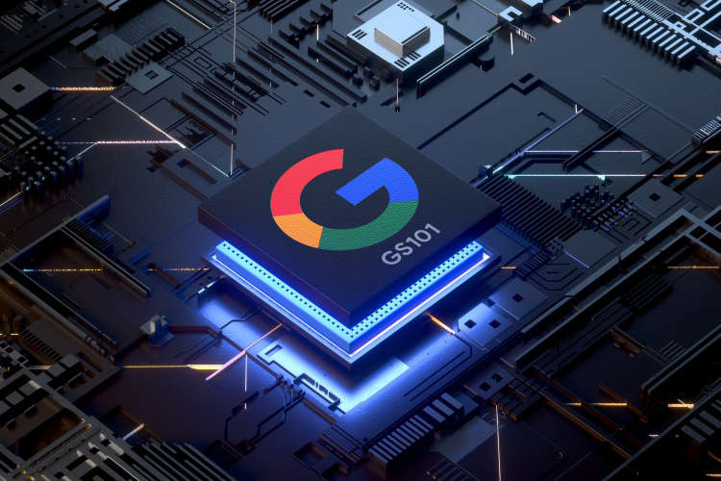

Processors with Neural Engine

Slide 8
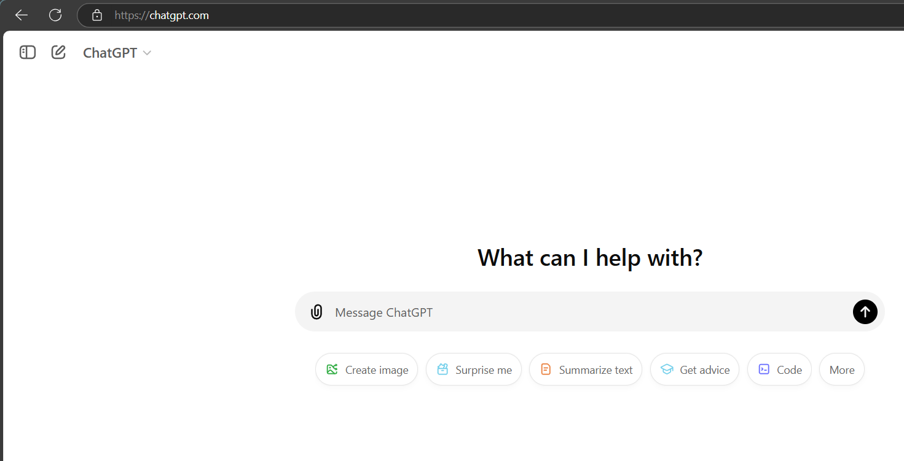
Gen AI Tools for end users (ChatGPT Web App)

Slide 9
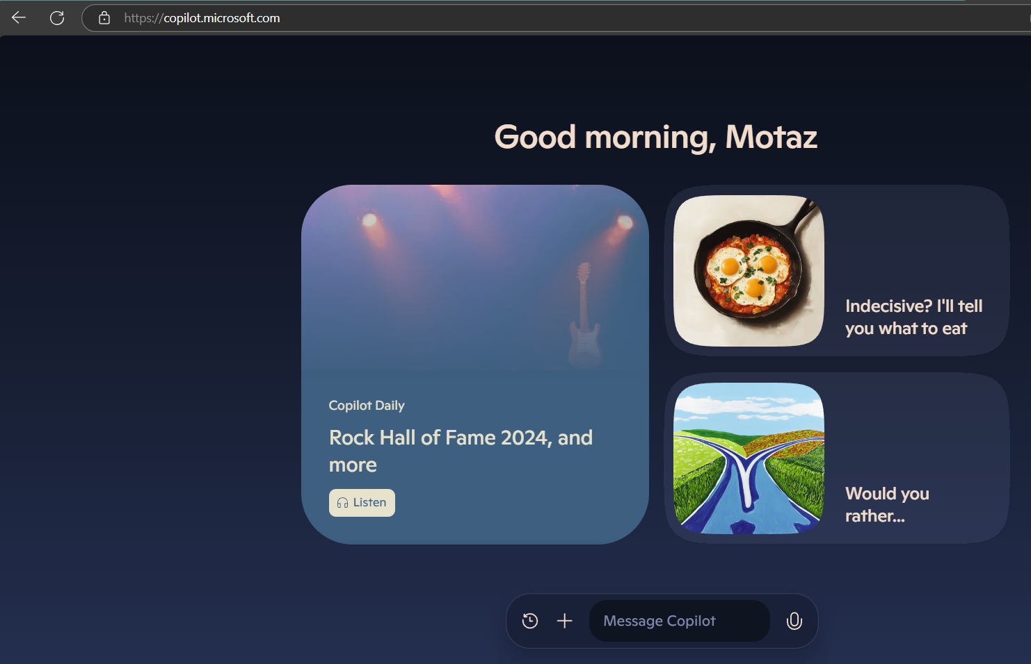
Gen AI Tools for end users (Copilot Web App)

Slide 10
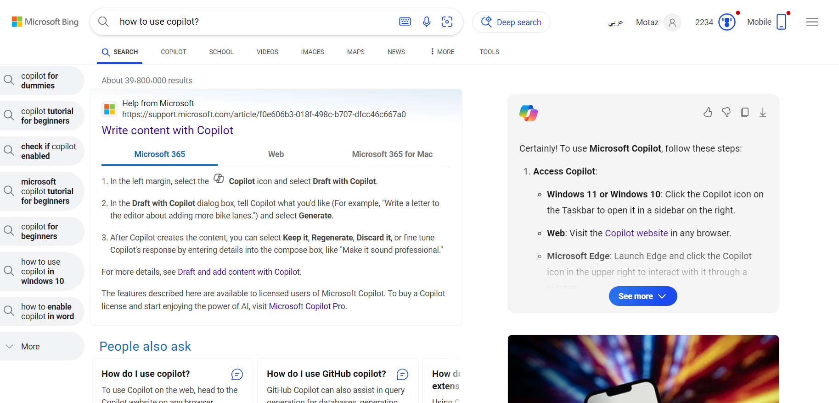
Gen AI Tools for end users (Copilot Web App)

Slide 11
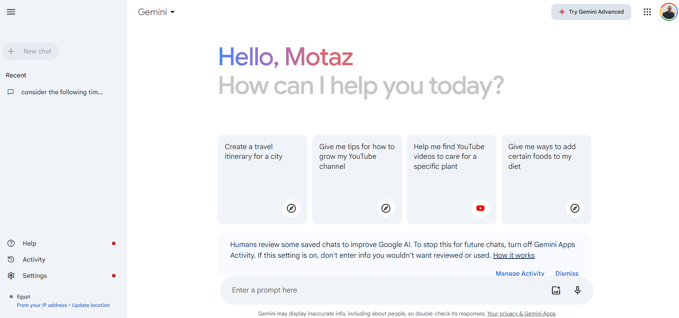
Gen AI Tools for end users (Gemini Web App)

Slide 12
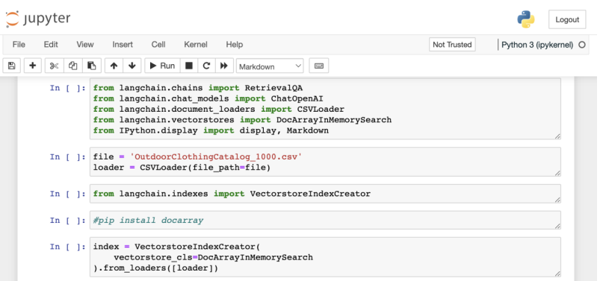
Generative AI is also a developer tool

Slide 13
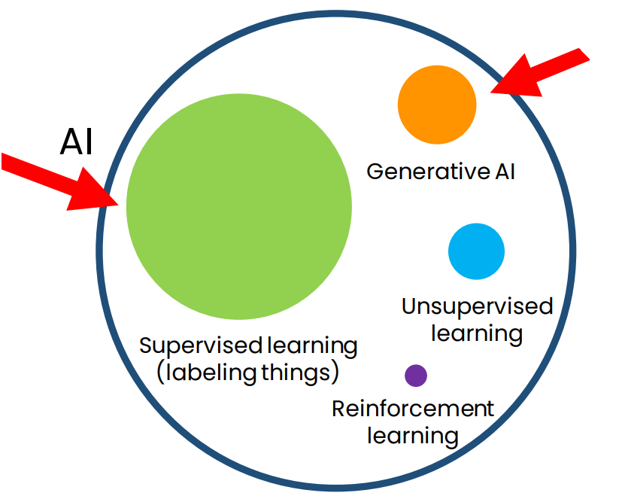
How generative AI works
AI is a set of tools

Slide 14
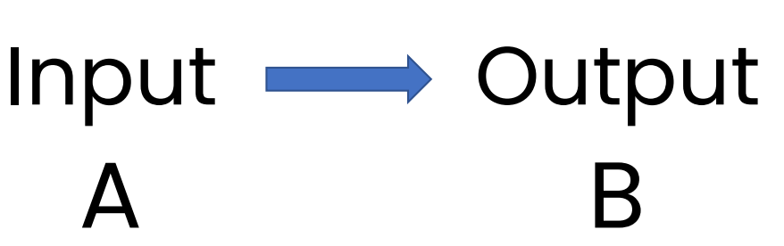
Supervised learning (labeling things)

Slide 15
Supervised learning (labeling things)
Input (A) ) | Output (B | Application
Email | Spam? (0/1) | Spam filtering
Ad, user info | Click? (0/1) | Online advertising
X-ray image | Diagnosis | Health-care
Image of phone | Defect? (0/1) | Visual inspection
Audio recording | Text transcript | Speech recognition
Restaurant reviews | Sentiment (+/-) | Reputation monitoring

Slide 16
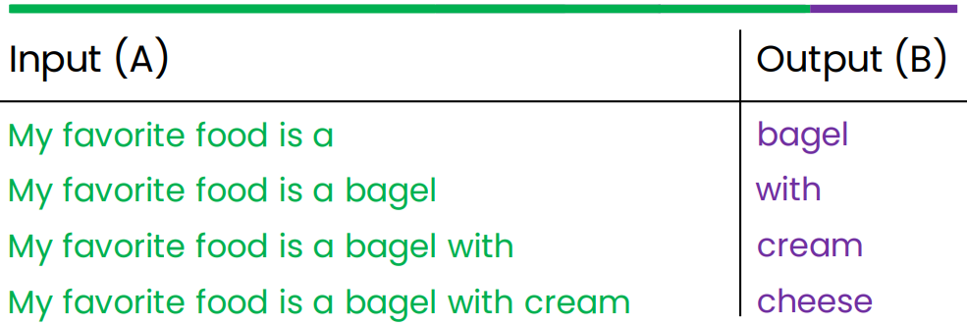
How LLMs work?
LLMs are built by using supervised learning (A→B) to repeatedly predict the next word.
My favorite food is a bagel with cream cheese
When we train a very large AI system on a lot of data (hundreds of billions of words), we get a Large Language Model like ChatGPT.

Slide 17
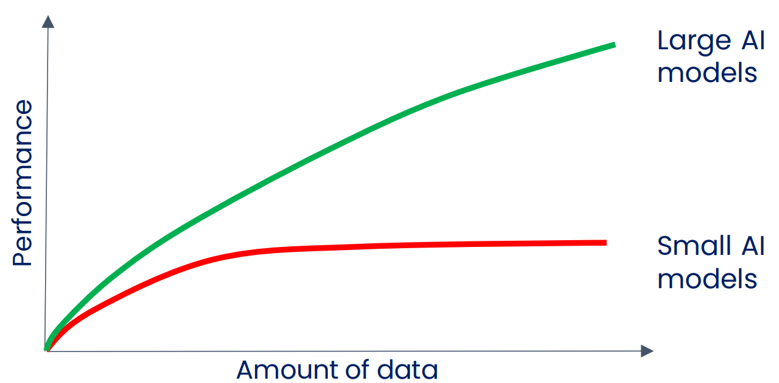
2010-2020: Large scale supervised learning

Slide 18
Large Language Models (LLMs)

Slide 19
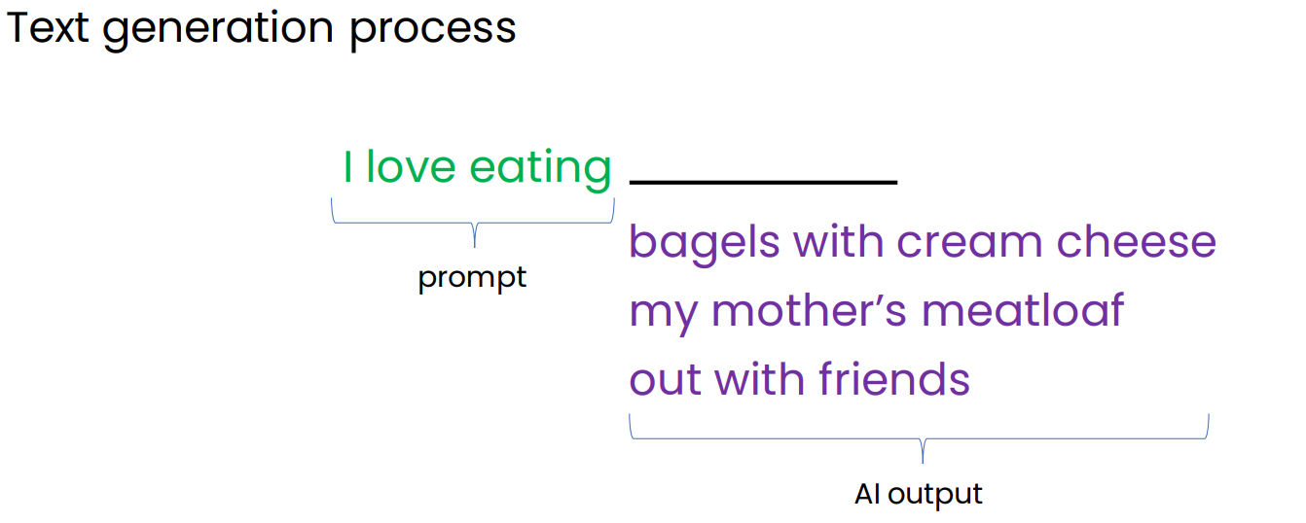
Generating text using Base LLM

Slide 20
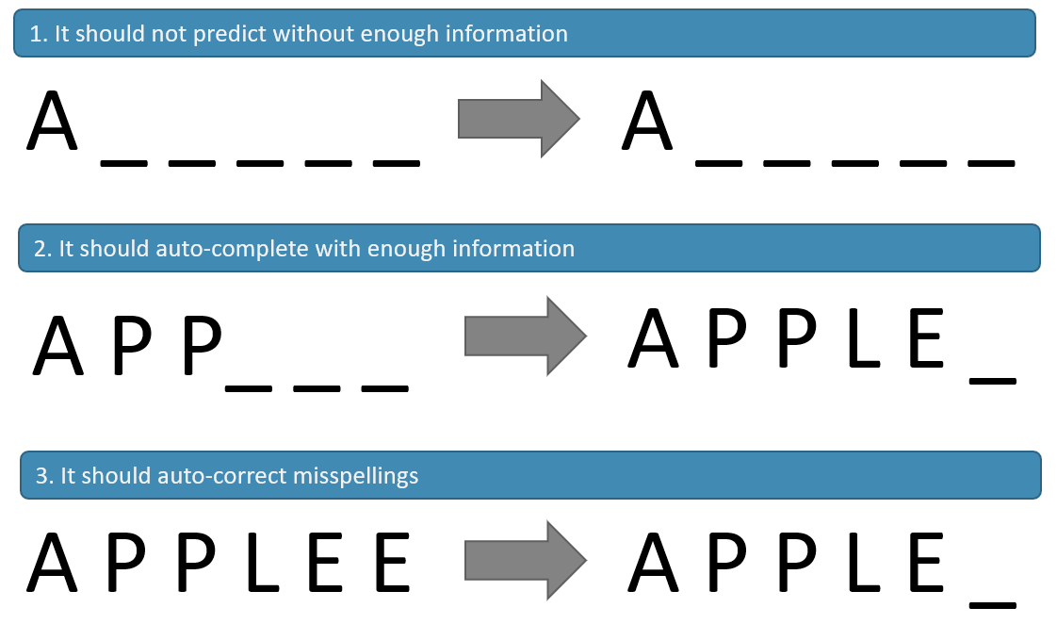
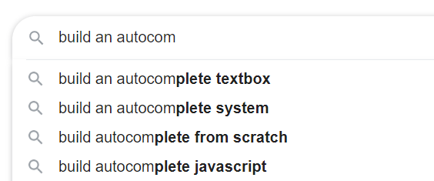
The Language Model

Slide 21
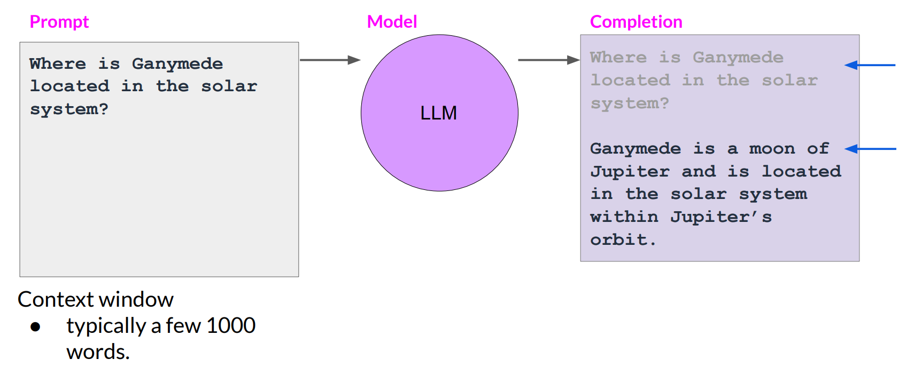
Prompts and completions

Slide 22



How LLMs work?
how to predict the next word?
learn from a huge text data such as books, Wikipedia, news articles, papers, magazines, ... etc.

Slide 23
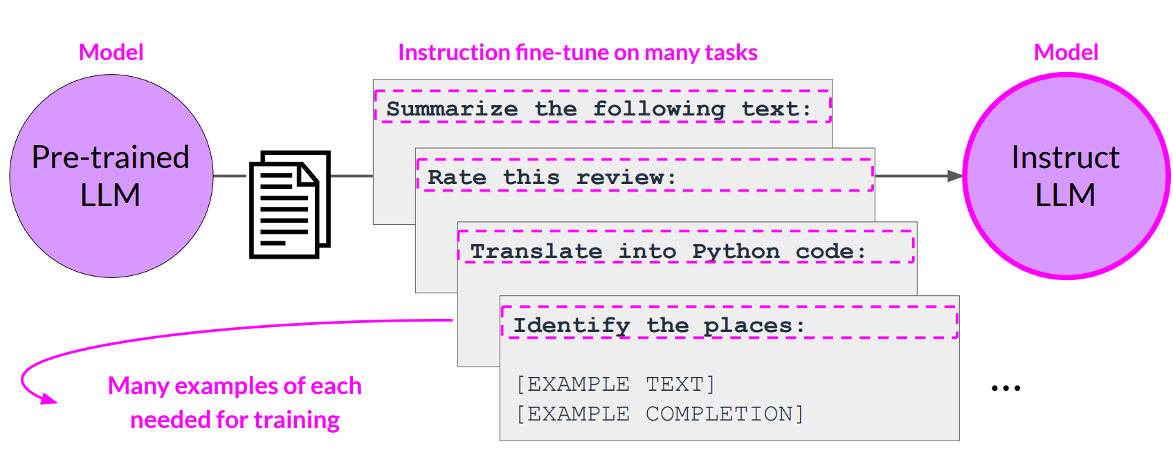
Multi-task, instruction fine-tuning

Slide 24
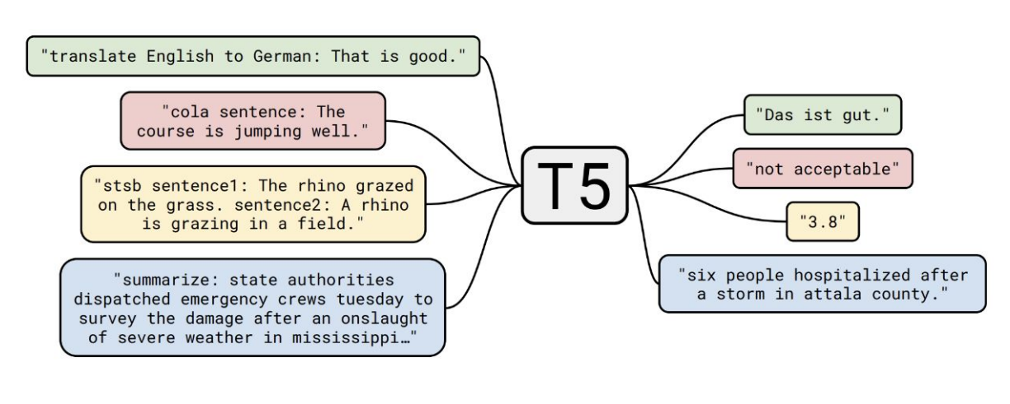
T5 LLM model used for several tasks

Slide 25
Types of LLMs
LLMs
Base LLM
Instruct LLM

Slide 26
Types of LLMs
Base LLM
Instruct LLM
Predicts the next word based on text training data.
Questions posed to Base LLM (no answers provided):
follow instructions but doesn’t always provide accurate answers.
Fine-tuned on instructions and good attempts at following them.
LLMs Reinforcement Learning with Human Feedback (RLHF)
Quality is measured via 3 measures
Helpful, Honest, Harmless: HHH
“Once upon a time, there was a unicorn that lived in a magical forest with all her unicorn friends.”
“What is the capital of France?
What is France’s largest city?
What is the currency of France?”
“What is the capital of France?
The capital of France is Paris.”

Slide 27
Helpful, Honest, Harmless: HHH
Helpful: Refers to the model’s ability to provide useful and relevant information or assistance.
Honest: Indicates that the model’s responses are truthful and transparent. When the model provides an answer, it aims to be honest rather than misleading or deceptive.
Harmless: Implies that the model’s outputs are not harmful or malicious. It won’t intentionally cause harm or negative consequences through its responses

Slide 28
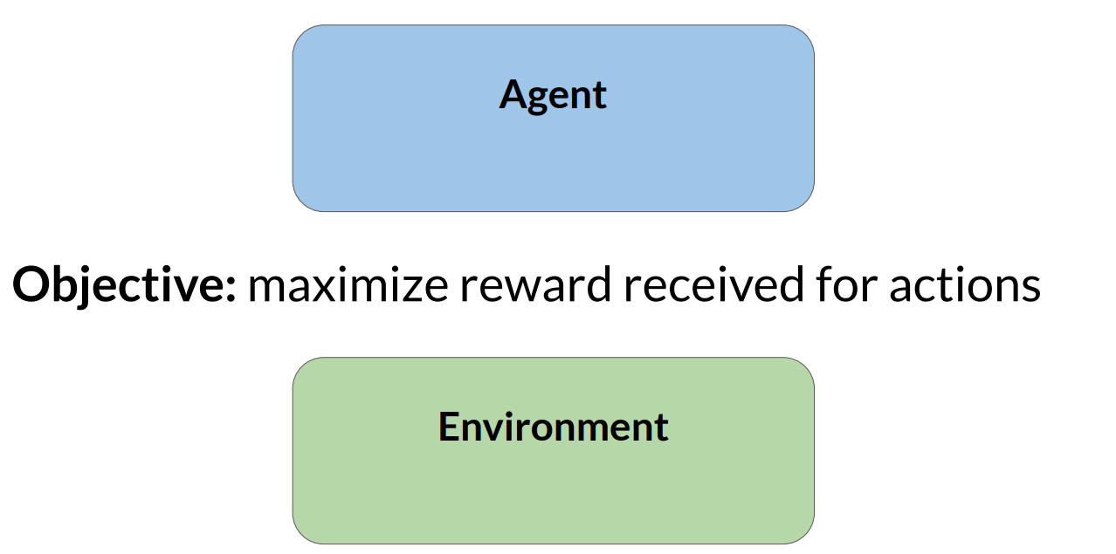
Reinforcement learning (RL)

Slide 29
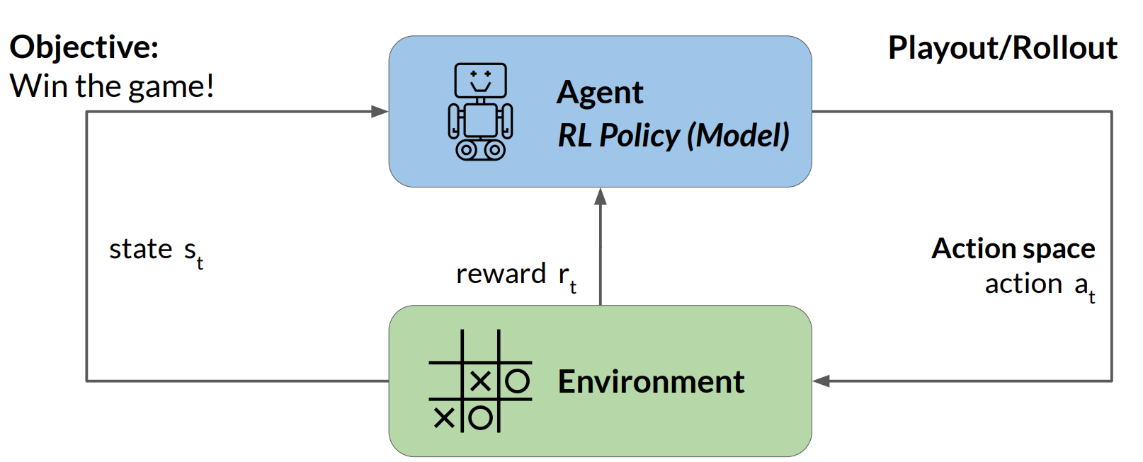
Reinforcement learning: Tic-Tac-Toe

Slide 30
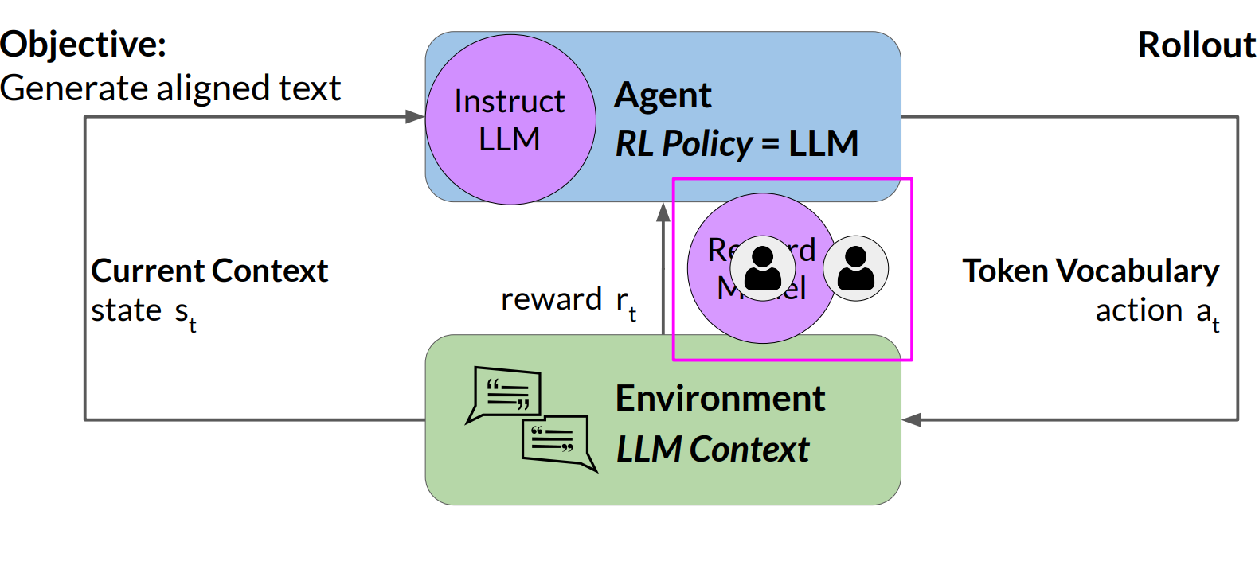
Reinforcement learning: fine-tune LLMs

Slide 31
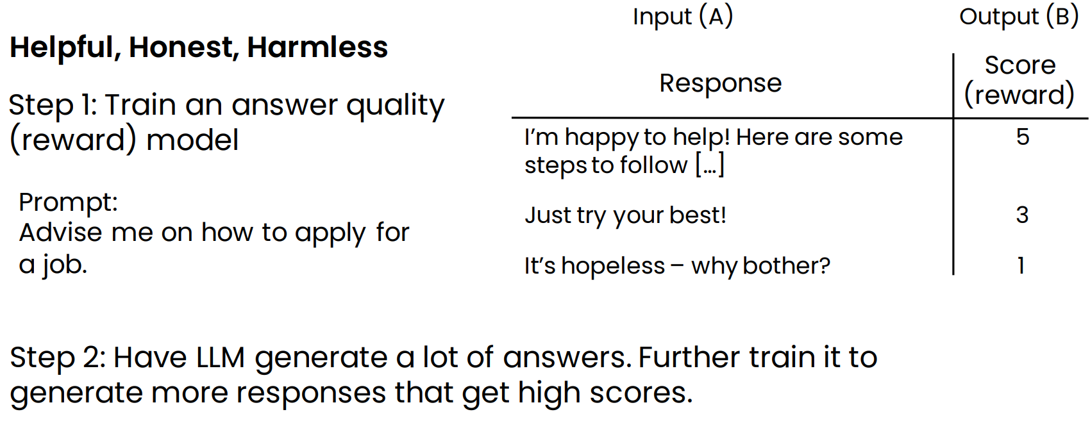
How do chat systems learn to follow instructions?
Reinforcement learning from human feedback (RLHF)

Slide 32
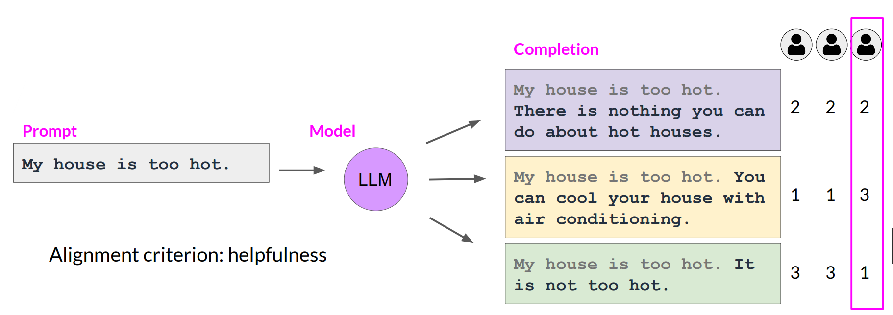
Collect human feedback
Define your model alignment criterion
For the prompt-response sets that you just generated, obtain human feedback through labeler workforce

Slide 33
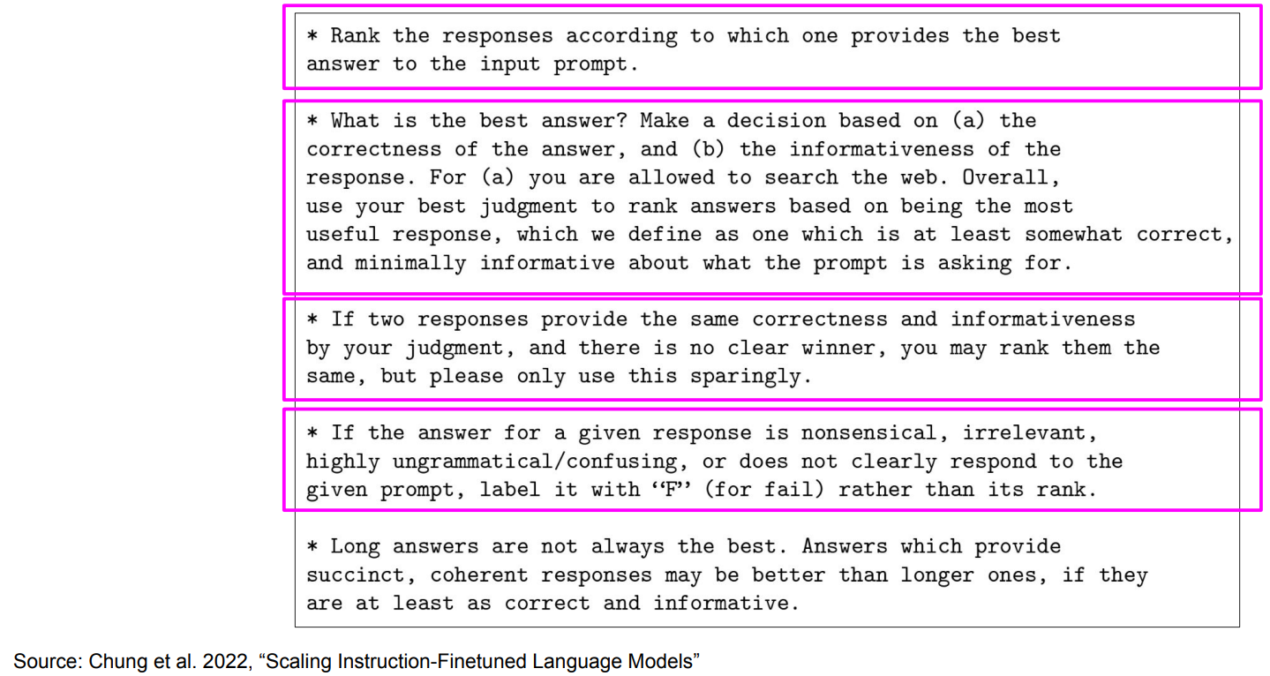
Sample instructions for human labelers

Slide 34
LLM size

Slide 35
Model size
# of Tokens:
The more text you feed a language model to train on, the better it is at providing human-like outputs across a large variety of domains.
# of Parameters:
The more parameters a model has, the larger its capacity to capture intricate nuances of language.

Slide 36
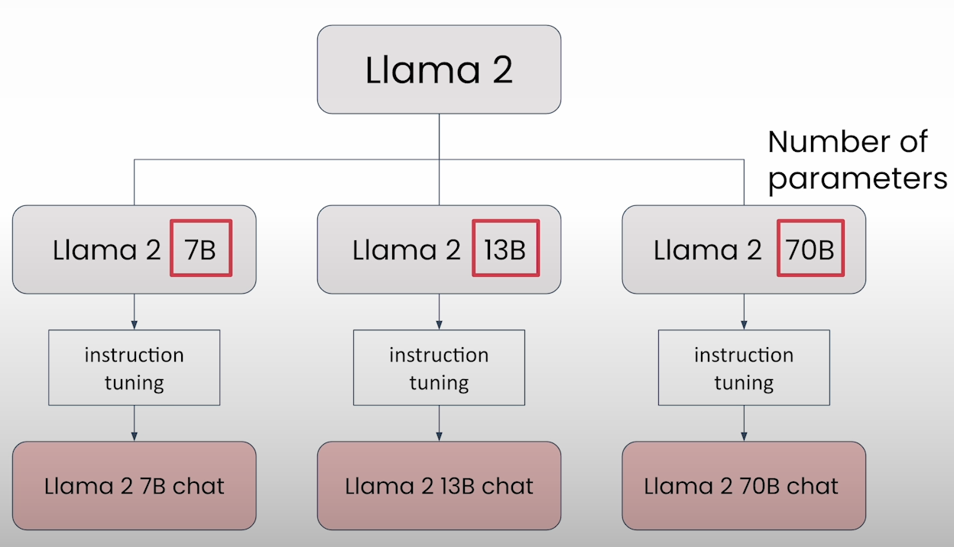
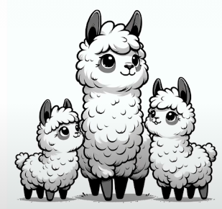
LLM Size (Llama 2)
Model size is identified by the number of parameters

Slide 37
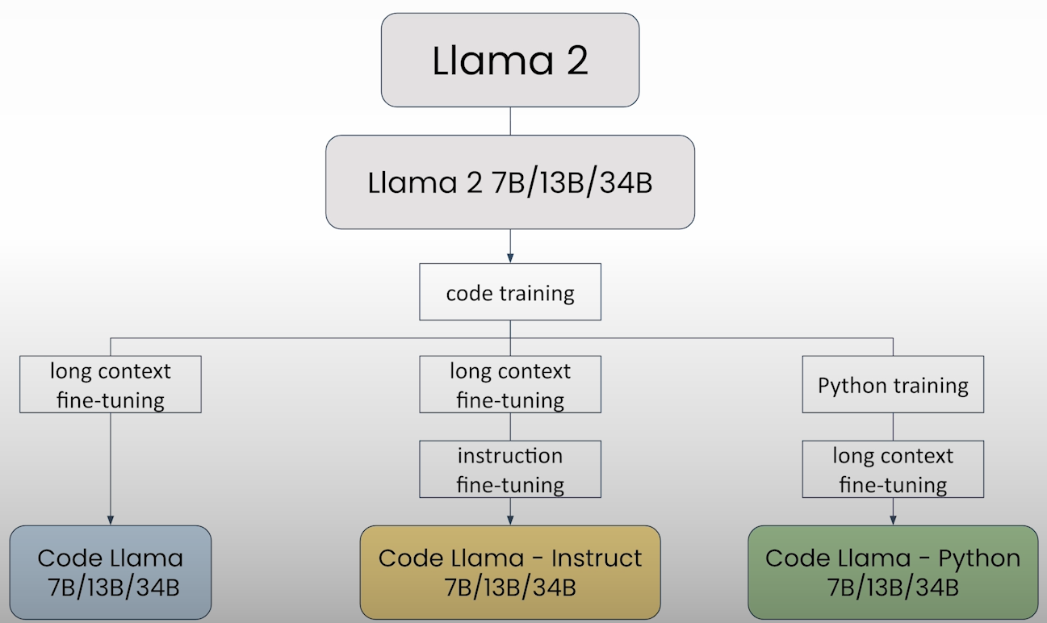
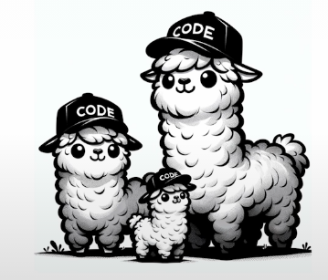
LLM Size (Code Llama 2)

Slide 38
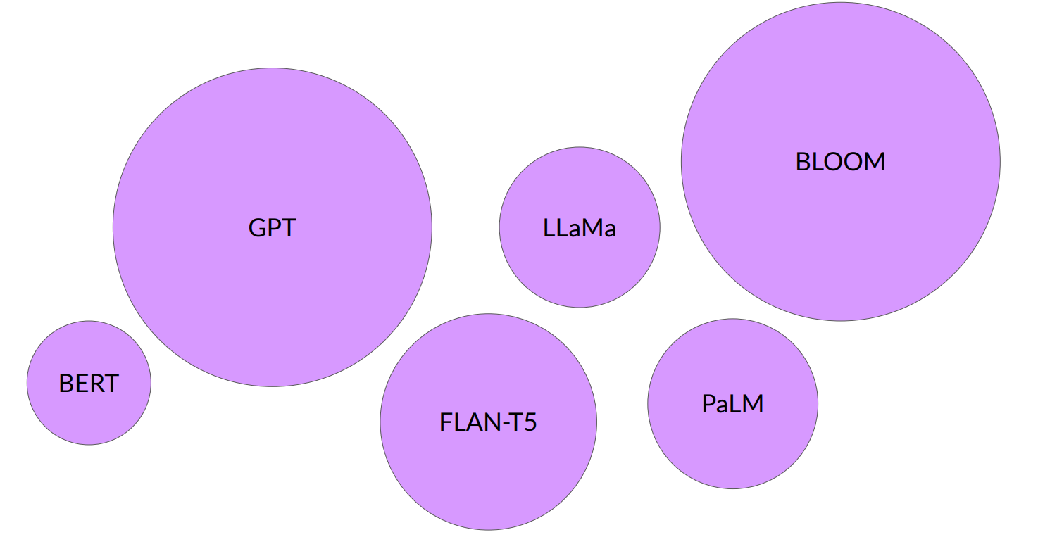
Large Language Models

Slide 39

The significance of scale: language understanding

Slide 40
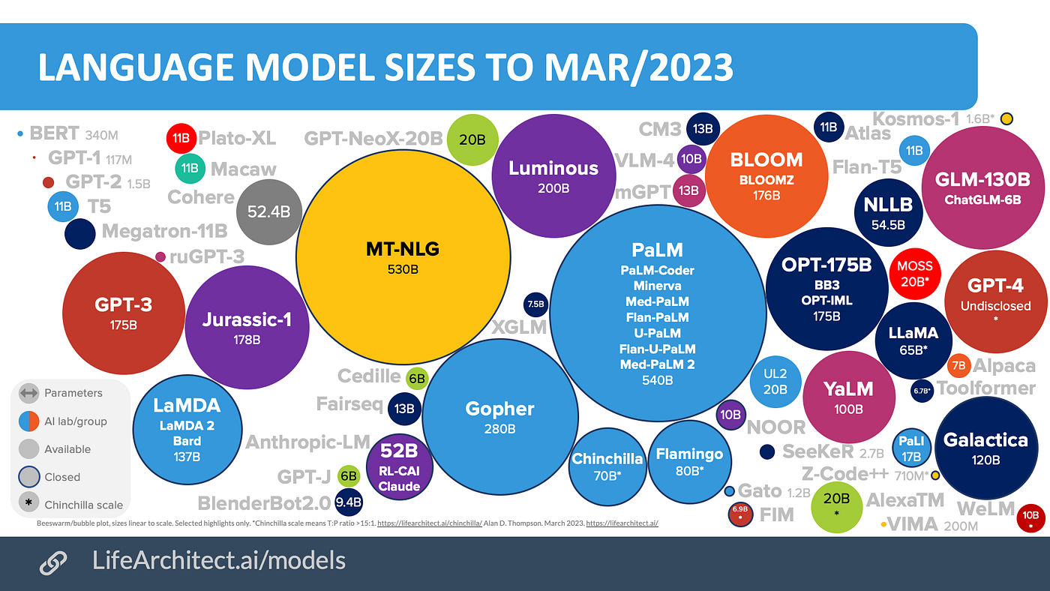

Slide 41
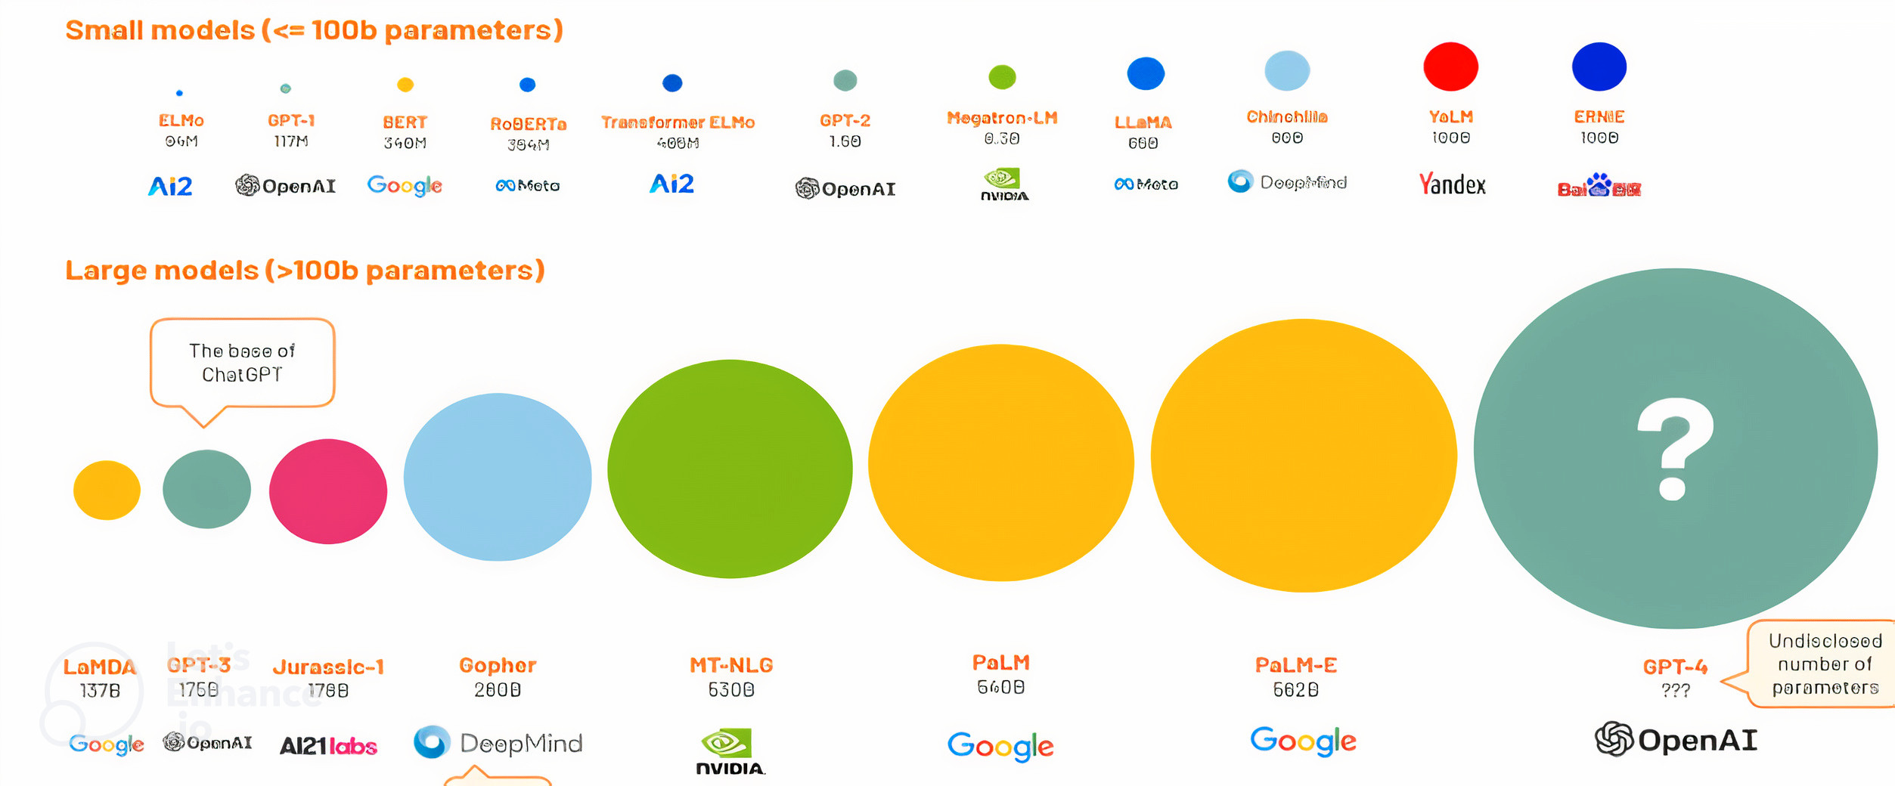
model size (# of parameters)
LLMs becoming small!!

Slide 42
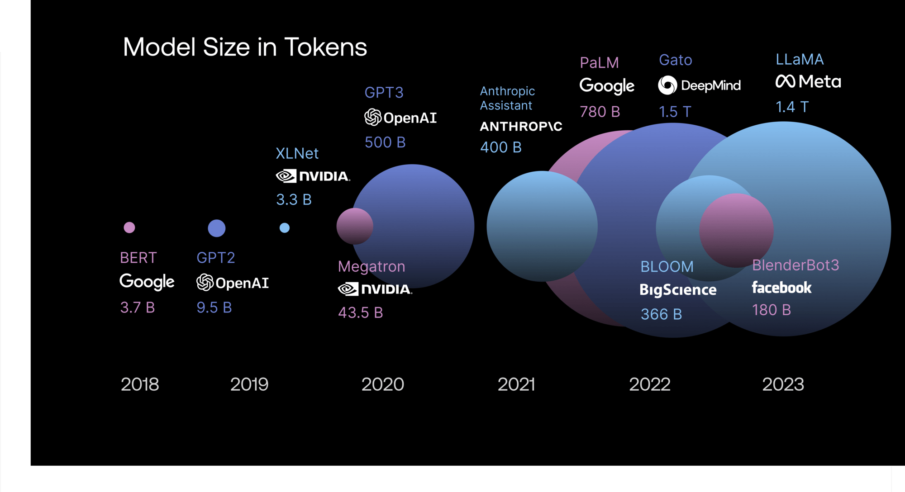
model size (# of tokens)

Slide 43
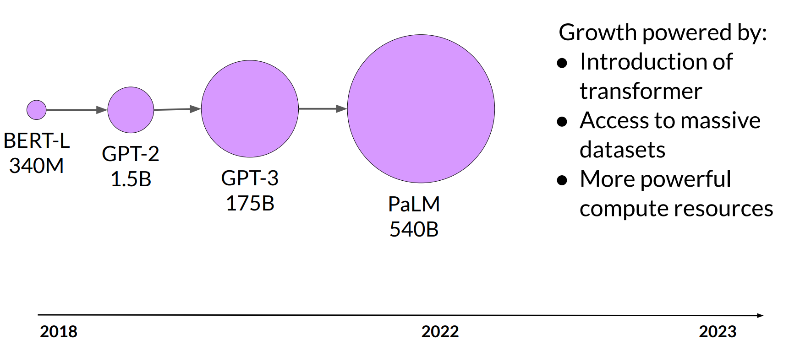
Model size vs. time

Slide 44
Model size
Parameters
~1B | Pattern matching and basic knowledge of the world.
~10B | Greater world knowledge. Can follow basic instructions
~100B+ | Rich world knowledge. Complex reasoning

Slide 45
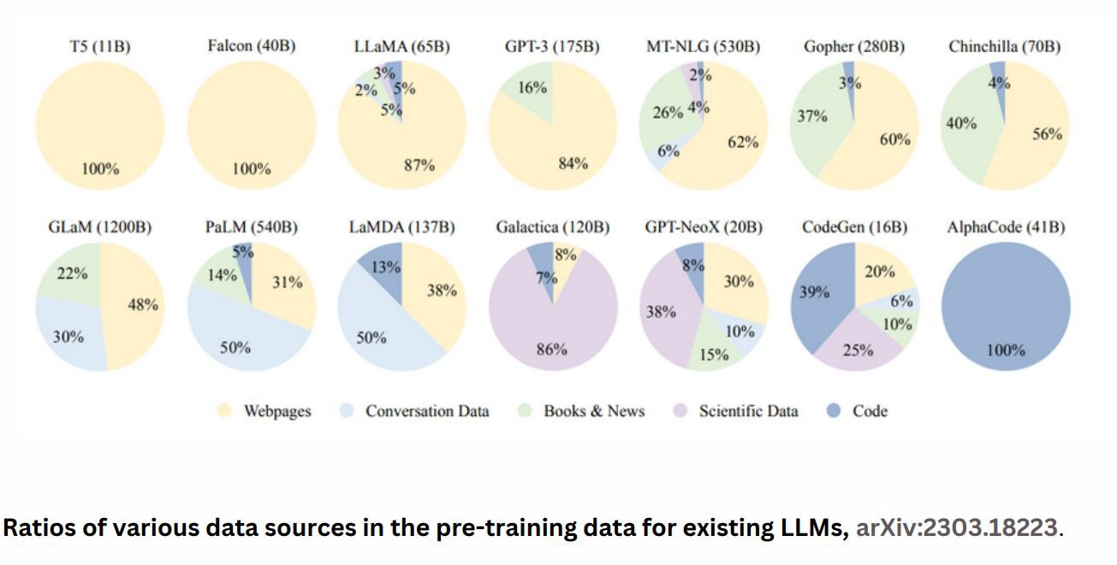
Training data domain

Slide 46
Technical Factors in choosing a LLM
Deciding which provider and foundational model would be a better choice depends on several factors including number of parameters, size of context window, training type, inference speed, cost,
fine-tunability as well as data security.
Number of Parameters: The number of parameters in a model can influence its capacity and performance. Larger models with more parameters often have the potential to capture more complex patterns and achieve higher accuracy. However, larger models also require more computational resources for training and inference.
Size of Context Window: The context window refers to the amount of text or context that the model considers when generating responses or predictions. Models with larger context windows have a broader understanding of the context, which can be advantageous for generating more contextually relevant outputs. However, larger context windows can also increase computational requirements and inference time.

Slide 47
Technical Factors in choosing a LLM
Training Type: Different models can be trained using various methods, such as supervised learning, unsupervised learning, or self-supervised learning. The training type can impact the model's capabilities and generalization across different tasks. Understanding the training methodology and evaluating its suitability for specific use cases is important.
Inference Speed: Inference speed is a crucial factor, especially in real-time or latencysensitive applications. Faster inference speeds allow for more responsive systems and better user experiences. Models with smaller architectures or optimized implementations tend to have faster inference times.
Cost: The cost of using a particular LLM includes considerations such as licensing fees, computational resources required for training and inference, and ongoing maintenance costs. Enterprises should evaluate the cost implications and ensure that the chosen LLM aligns with their budget and cost expectations.

Slide 48
Technical Factors in choosing a LLM
Fine-tunability: The ability to fine-tune the model to adapt it to specific use cases is valuable. Enterprises should consider the level of fine-tuning flexibility and the availability of resources and documentation for this process. Some models may offer more extensive fine-tuning capabilities than others.
Data Security: Data security is of paramount importance when working with LLMs. Enterprises should assess the data security practices of the provider, including encryption methods, access controls, and compliance with privacy regulations. Protecting sensitive data and ensuring secure handling and storage is crucial.
While all the factors mentioned pose their own challenges, one of the biggest challenges currently is striking the right balance between model performance and computational resources.

Slide 49
Closed or open source?
Closed-source
Open-source
Easy to use in applications
More large/powerful models
Relatively inexpensive
Some risk of vendor lock-in
Full control over model
Can run on your own device (on-prem, PC, etc.)
Full control over data privacy/access

Slide 50
How to use LLM? What is Possible?!

Slide 51
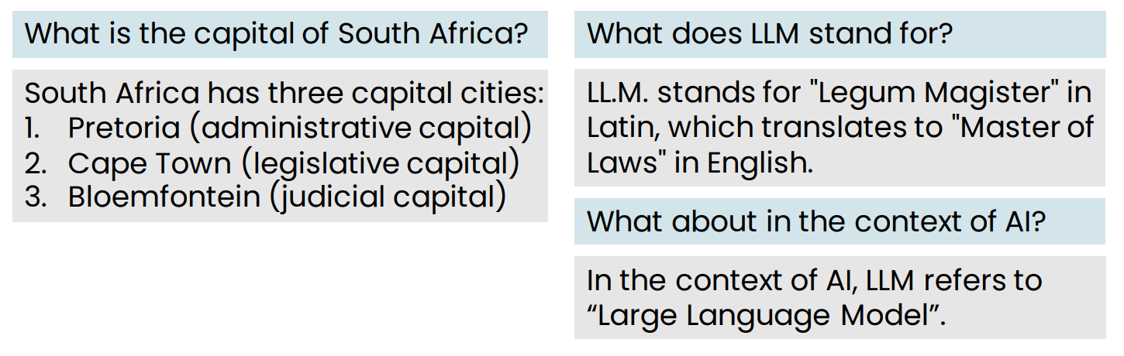
LLMs as a thought partner
LLMs is a new way to find information

Slide 52
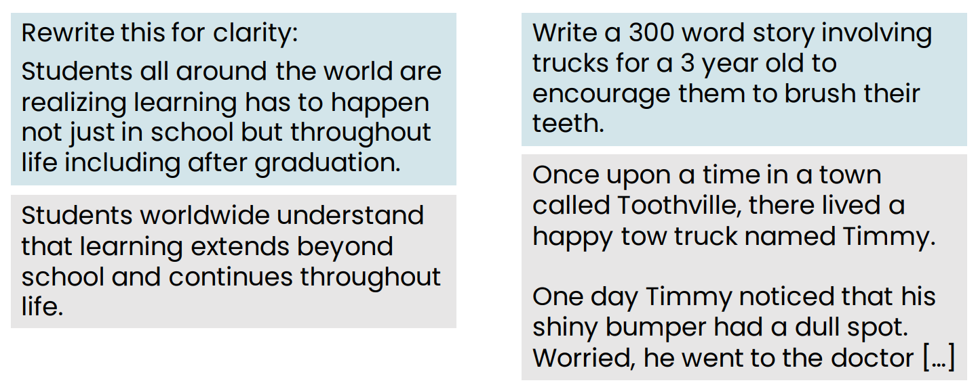
Writing partner

Slide 53
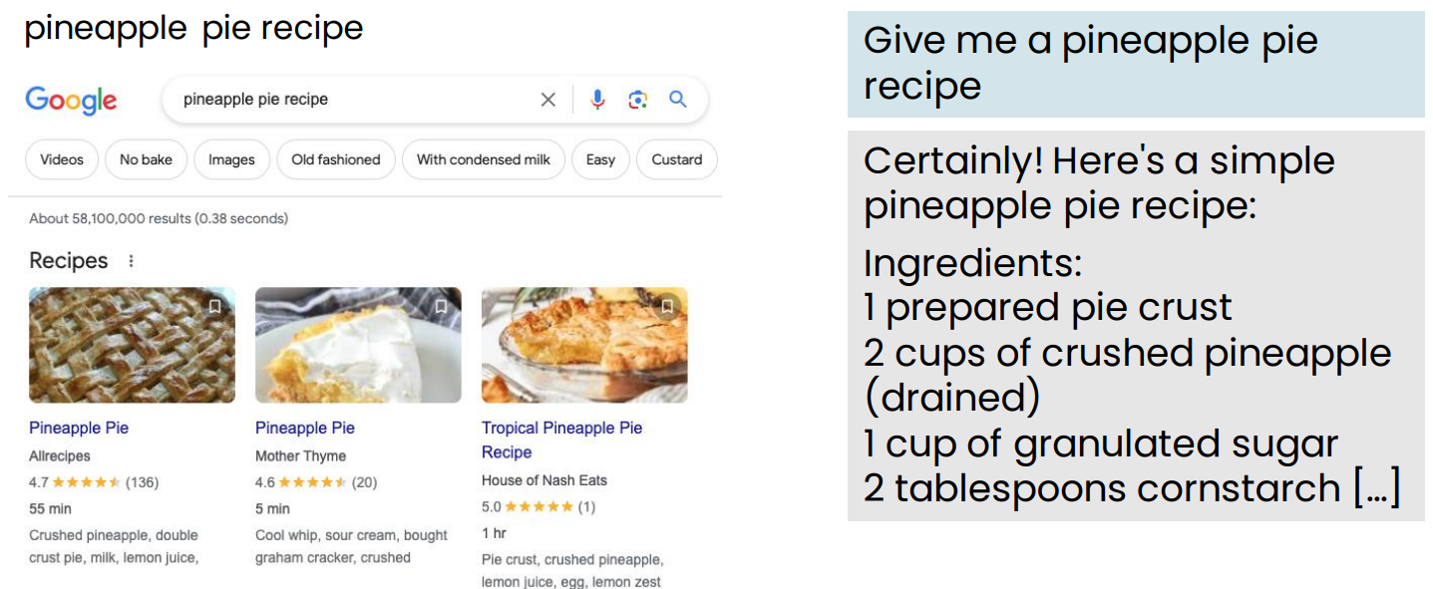
Web search or using an LLM?

Slide 54
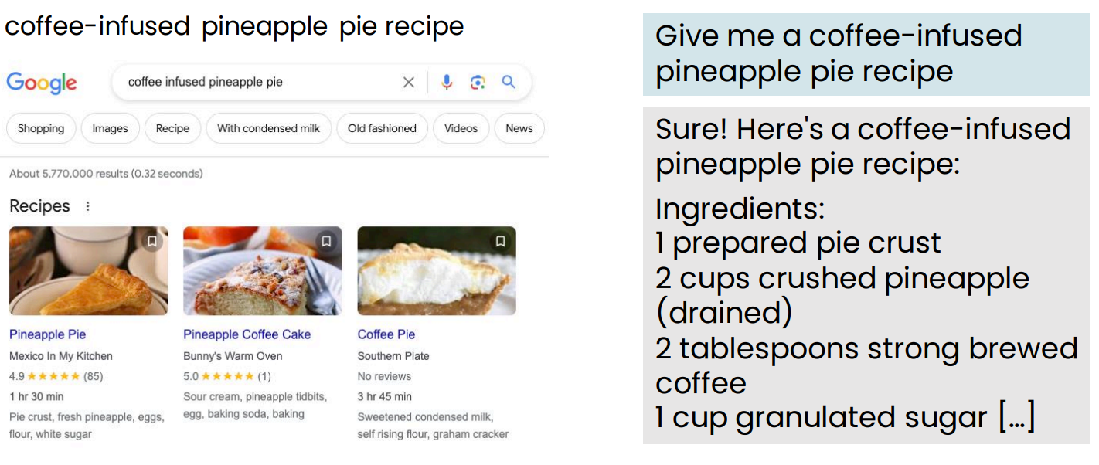
Web search or using an LLM?

Slide 55
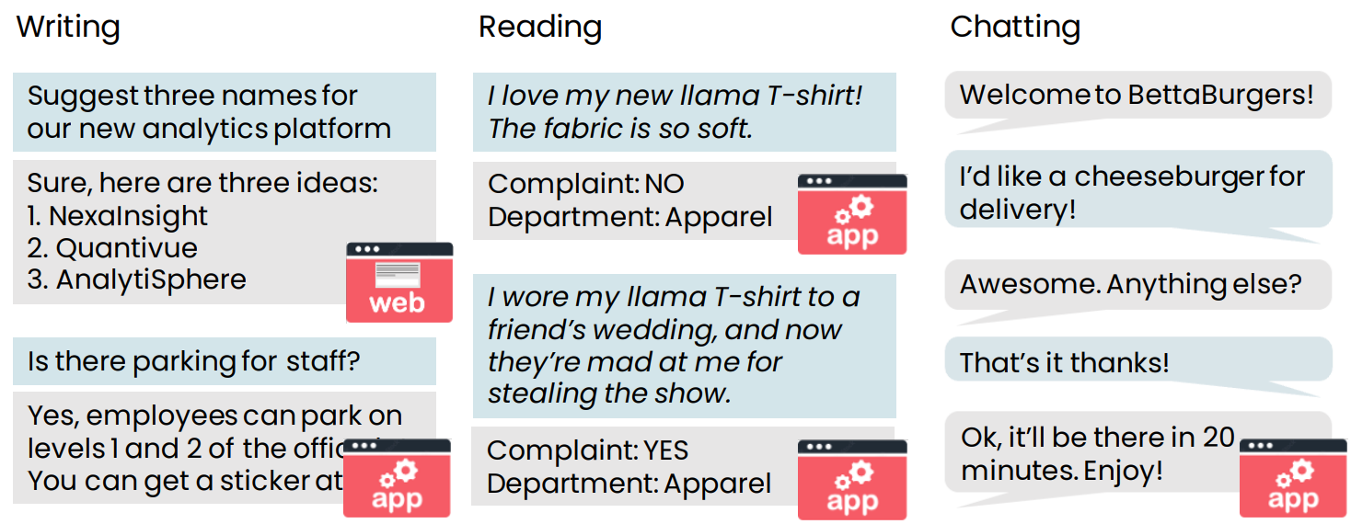
Examples of tasks LLMs can carry out

Slide 56
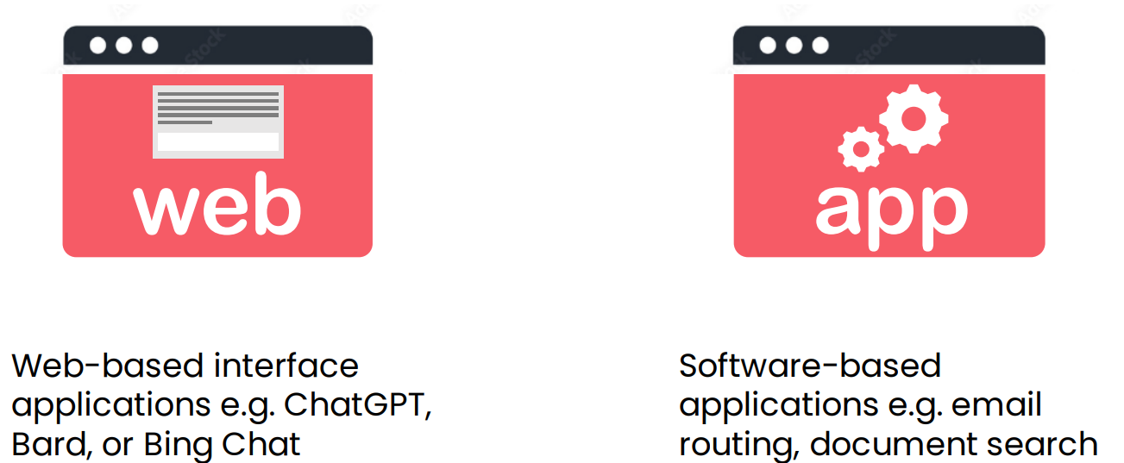
Web-based vs. software application use of LLMs

Slide 57
Brainstorming product names
Brainstorm 5 creative names for peanut butter cookies
Sure thing! Here are some ideas:
1. Nutty Nirvana Nibbles
2. ButterBite Bliss
3. Peanut Paddle Pucks
4. ButterNutter Crunchies
5. Nutty Nom-Nom Nuggets

Slide 58
Developing sales strategy
Brainstorm five ideas for increasing cookie sales in Q4
1. Limited-time only seasonal flavors.
2. Beautifully packaged gift sets.
3. Buy more, save more deals.
4. Interactive holiday displays
5. Recipe cards

Slide 59
Writing a press release
Write a press release announcing the hire of a new COO
[Company Name] Welcomes [New COO’s Full Name] as
Chief Operations Officer
[City, State, Date] – [Company Name], a leading [brief
description of the company’s industry or niche], is thrilled
to announce [New COO’s Full Name] as its new Chief
Operations Officer (COO). [New COO’s first name] brings a
wealth of experience […]

Slide 60
Writing a press release – improved prompt
Write a press release announcing the hire of our new COO using the following information:
COO bio: Nadiya Grenner received her MBA from Cornell…
Company info: General Robotics, headquartered in Boston, MA, is a leader in robotics research and manufacturing…
General Robotics Welcomes Nadiya Grenner as Chief
Operations Officer Boston, MA – General Robotics, a leading robotics research and manufacturing company, is thrilled to announce
Nadiya Grenner as its new COO. A graduate of Cornell’s […]

Slide 61
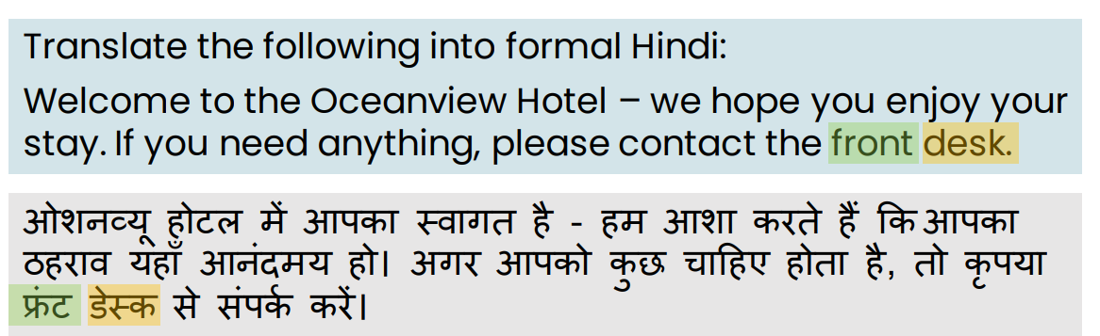
Translation

Slide 62
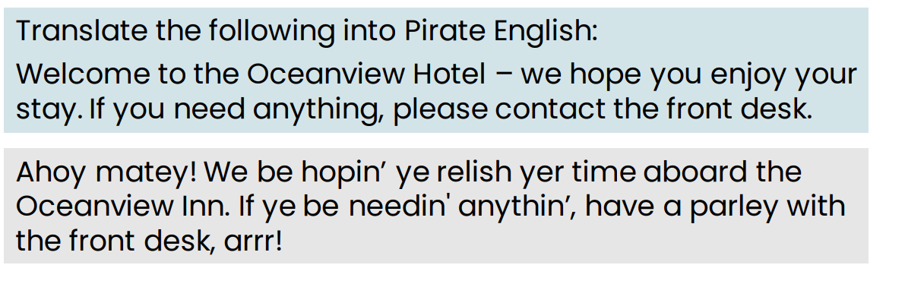
Translation: Pirate English
Notes:
Arr, matey! Pirate English be the language spoken by swashbucklin' pirates on the high seas. It's a whimsical and playful way of talkin', full of colorful phrases, nautical terms, and hearty "Arrrrs!" If ye want to sound like a true buccaneer, give it a try! 🏴‍☠️⚓
If ye be lookin' to translate words into Pirate Speak, ye can use this [Pirate Speak Translator](https://lingojam.com/PirateSpeak). Fair winds and follow the stars, me heartie! 🌊🗺️
Source: Conversation with Copilot, 7/14/2024
(1) Pirate Speak Translator ― LingoJam. https://lingojam.com/PirateSpeak.
(2) PIRATE definition and meaning | Collins English Dictionary. https://www.collinsdictionary.com/dictionary/english/pirate.
(3) pirate noun - Definition, pictures, pronunciation and usage notes .... https://www.oxfordlearnersdictionaries.com/definition/english/pirate_1.
(4) PIRATE | definition in the Cambridge English Dictionary. https://dictionary.cambridge.org/us/dictionary/english/pirate.
(5) Pirate Monkeyness Insults and Translations. https://pirate.monkeyness.com/translate.

Slide 63
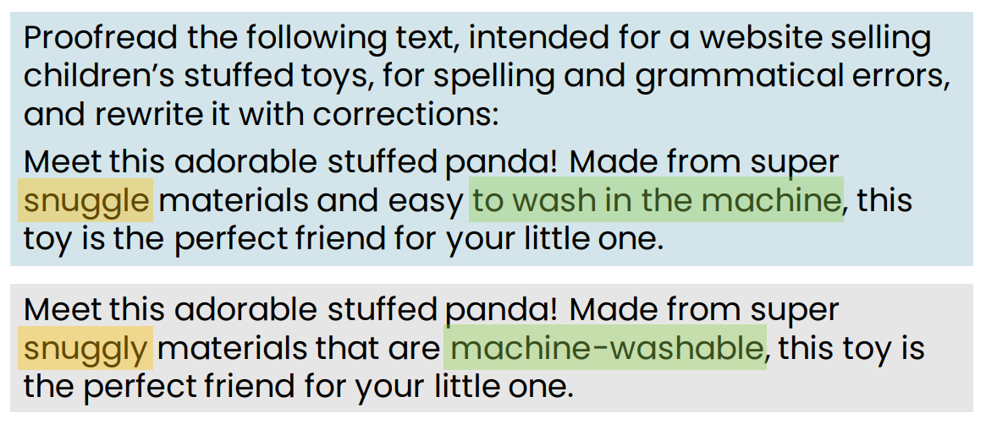
Proofreading

Slide 64
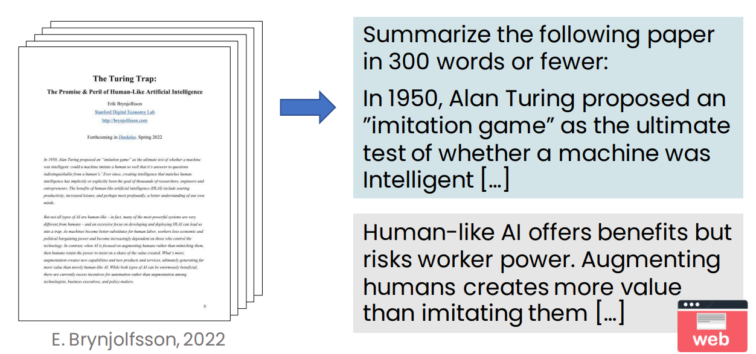
Summarizing an article

Slide 65
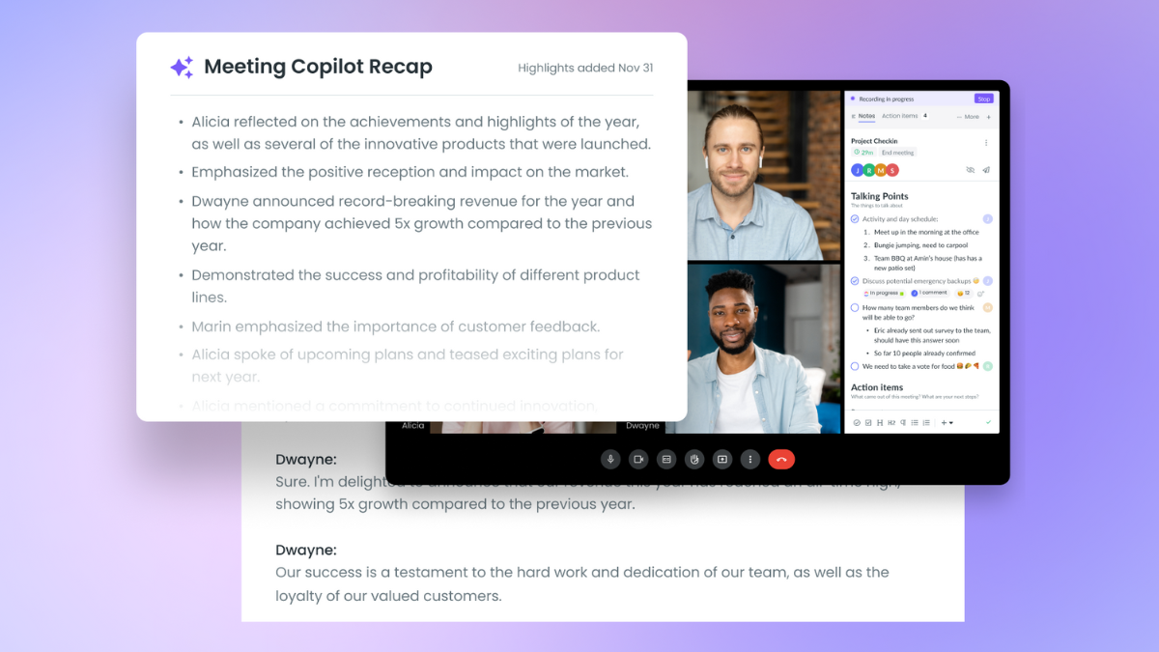
Meeting Copliot recap in MS Teams

Slide 66
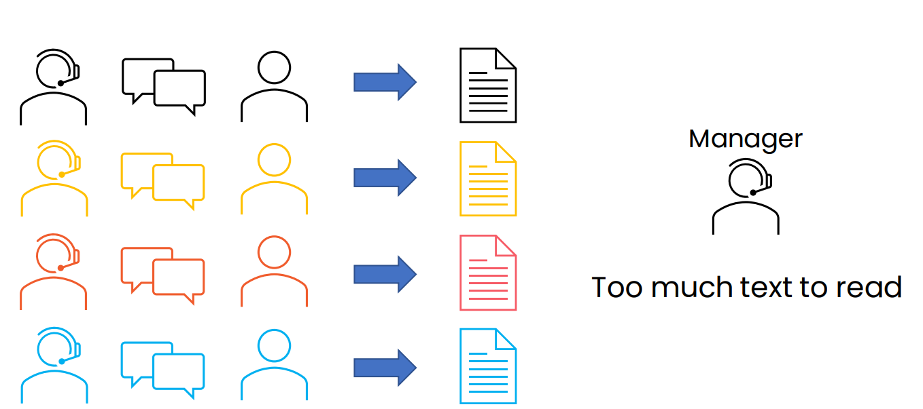
Summarizing call center conversations

Slide 67
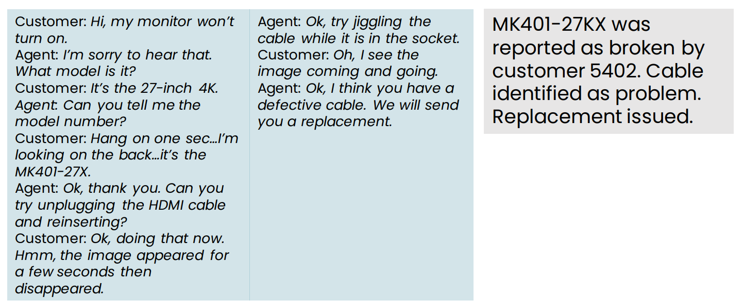
Summarizing conversations

Slide 68
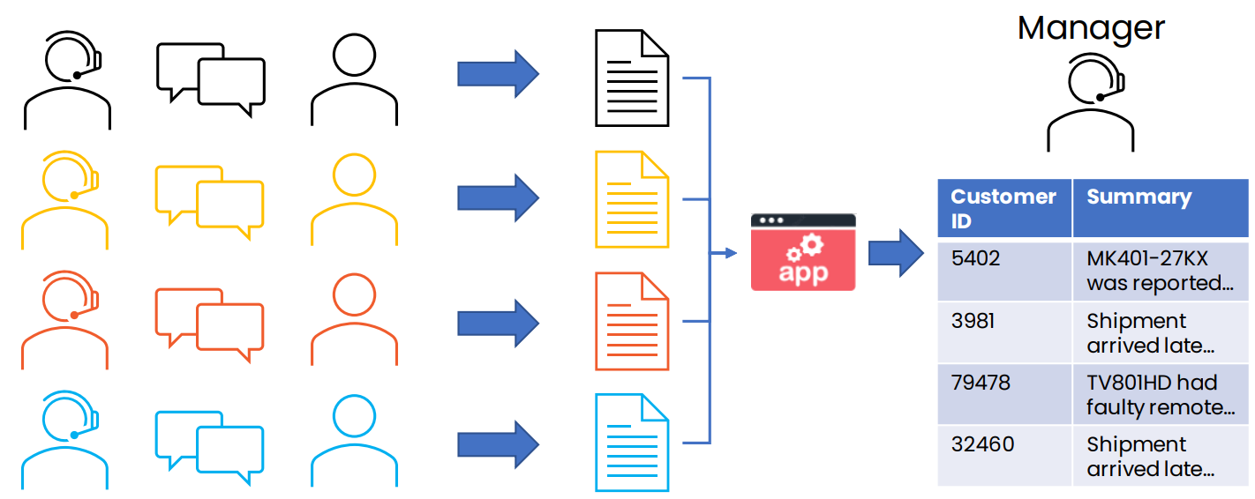
Summarizing call center conversations

Slide 69

Customer email analysis

Slide 70

Detailed look at email routing prompt

Slide 71

Dashboard to track customer sentiment over time

Slide 72

LLM use cases & tasks

Slide 73
LLM as reasoning engine
LLMs have a lot of general knowledge, but they don’t know everything
By providing relevant context in the prompt, we ask an LLM to read a piece of text, then process it to get an answer
We’re using it as a reasoning engine to process information, rather than using it as a source of information

Slide 74
What LLMs can and cannot do

Slide 75


What LLMs can and cannot do
What prompting an LLM can do
Can a fresh college graduate follow the instructions to complete the task?
Determine if an email is a complaint?
Determine if a review is positive or negative?

Slide 76
What LLMs are Good vs Bad at
LLMs are good at
LLMs are bad at
Language translation
Content summarization
Content generation
Writing support
Question answering
Correcting spelling and grammar
Programming support
Classification (spam detection)
Simplifying complex content
Stylized writing
Sentiment analysis
Current events
Common sense
Math/counting
Handling uncommon scenarios
Consistency
High-level strategy
Being factual 100% of the time
Reasoning & logic
Emotional intelligence
Representing minorities
Extended recall/memory

Slide 77

Knowledge cut-offs in LLMs

Slide 78

Knowledge cutoffs
An LLM’s knowledge of the world is frozen at the time of its training
A model trained on data scraped from internet in January 2022 has no information about more recent events

Slide 79

Making things up: Hallucinations

Slide 80

Making things up: Hallucinations

Slide 81

Tools for reasoning
LLM in general are bad in calculations, that is why agents are used to help.

Slide 82

Agents
Use LLM to choose and carry out complex sequences of actions
Cutting edge area of AI research

Slide 83

The input (and output) length is limited
Many LLMs can accept a prompt of up to only a few thousand words.
The total amount of context you can give it is limited

Slide 84
The input (and output) length is limited
Many LLMs can accept a prompt of up to only a few thousand words.
The total amount of context you can give it is limited
Some LLMs have longer context limits – up to 100,000 words
An LLM’s context length is the limit on the total input+output size

Slide 85


Q&A

